Slide 1
Lecture 4b Problems and Algorithms

Slide 2
Problems and Problem Solving
Algorithms solve problems. We need to start with understanding what a problem is

Slide 3
Problems
4 different definitions (types of problems) are used in Computation theory and Algorithm analysis and design
Decision problems
Function problems (function evaluation problems)
Search problems
Optimization problems

Slide 4
Problems
A decision problem is a subset of X, D⊆X (equivalently, a function D: X→{0,1}).
A function problem is a function f: X→Y.
A search problem is a relation S: X→Y (i.e., a function S: X→Pow(Y)).
An optimization problem is a search problem, with an additional real-valued function eval: S→R added.

Slide 5
Problems
Decision problems
A question in some formal system with a yes-or-no (1-0) answer, depending on the values of some input parameters.
Determine for which elements of X a property holds
A decision problem is (defines) a set [of the elements for which the answer is yes]

Slide 6
Problems – Decision problems
X
D
1 (True)
0 (False)

Slide 7
Problems
Decision problems
Examples:
Given two numbers a and b, does a evenly divide b?
In a given graph G, does there exist a path between two given nodes N and M?
In a given weighted graph G, does there exist a path between the two given nodes N and M of length ≤100?

Slide 8
Problems
A decision problem is a subset of X, D⊆X (equivalently, a function D: X→{0,1}).
A function problem is a function f: X→Y.
A search problem is a relation S: X→Y (i.e., a function S: X→Pow(Y)).
An optimization problem is a search problem, with an additional real-valued function eval: S→R added.

Slide 9

Problems
Function problems
They have answers that are more complex than a simple 'yes' or 'no'.
Examples:
Given two numbers a and b, what is the quotient a/b?
Given a weighted graph G and nodes N and M in G, what is the minimum length of a path from N to M?
Can be viewed as functions in mathematical sense – the solution to the problem is computing this function. An algorithm solving the problem calculates the function.
In 1st example, X = AxB

Slide 10
Problems
A decision problem is a subset of X, D⊆X (equivalently, a function D: X→{0,1}).
A function problem is a function f: X→Y.
A search problem is a relation S: X→Y (i.e., a function S: X→Pow(Y)).
An optimization problem is a search problem, with an additional real-valued function eval: S→R added.

Slide 11
Problems
Search problems
Assume that sets X and Y are given as well as a relation S: X →Y, S⊆X×Y is somehow specified. For x∈X, denote by
S(x)= {y:<x,y>∈S} the image of x through S. In particular, S(x) may be empty or infinite.
We refer to S as the set of all feasible (valid) solutions; a solution is a pair <x,y> ∈S.
A search problem is an ordered triple <X,Y, S> (less precisely, a search problem is S).

Slide 12
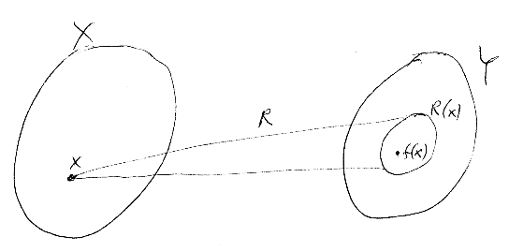
Problems
S(x)
S

Slide 13
Problems
Search problems
We say that a partial function f: X → Y solves the search problem <X, Y, S> iff the following two conditions hold:
f(x) is not defined if S(x)=∅
f(x)∈S(x) if R(x)≠∅
In other words, function f solves the search problem S iff it assigns to every input x either an output y where <x,y> is a feasible solution of x if feasible solutions including x exist, and is undefined otherwise.

Slide 14
Problems
Examples of search problems:
Given a weighted graph G and nodes N and M in G, find a path from N to M.
Find a valid solution to a system of linear equations.
Sort a list of numbers.
Find an occurrence of a given pattern in a given string.
What we are looking for is, for an input x to find a single output y such that <x,y> is a feasible solution if such exists, not all feasible solutions.

Slide 15
Enumeration problem
We want to find all paths from N to M – a list of all shortest paths. This actually is a function problem – the result is the list (the enumeration of all shortest paths)

Slide 16
Problems
A decision problem is a subset of X, D⊆X (equivalently, a function D: X→{0,1}).
A function problem is a function f: X→Y.
A search problem is a relation S: X→Y (i.e., a function S: X→Pow(Y)).
An optimization problem is a search problem, with an additional real-valued function eval: S→R added.

Slide 17
Optimization Problems
Optimization problems are a further extension of search problems where, in addition to S which specifies the feasible solutions, an evaluation function (also called objective function, cost function, fitness function, or solution quality function) eval is given which evaluates the solutions: eval: S → R⁺.
In an optimization problem, for a given input we are looking for a solution <x,y> which is optimal (either min or max).
There might be more than one optimal solutions for input x; we want to find any one of them.

Slide 18
Problems
Optimization problems
Example:
Find a shortest path between two given nodes in a given weighted graph

Slide 19
Output-solution assumption
Often we consider the problem instance x∈X to be specified (chosen). E.g., the initial node of a graph is given.
Formally, X is a one-element set, X={x}.
In such a case we practically equalize the notions of output y∈Y and feasible solution <x,y>∈S.
Now, a search problem degenerates to simply a set S of feasible solutions called a search space (also solution space, or configuration space, or state space).
The solution space is only a set (not a graph).

Slide 20
Output-solution assumption
Under the output-solution assumption X={x} a search problem S: X→Y degenerates to a decision problem S(x)⊆Y.
Similarly, an optimization problem becomes simply a function eval: S → R.
Optimization problems turn out to be now a generalization of decision problems rather than of search problems.

Slide 21
State-Space Landscape
Extension of the state space (solution space)
In a state-space landscape we have
Location: state
Elevation: value of objective function
Elevation is an additional coordinate
21

Slide 22

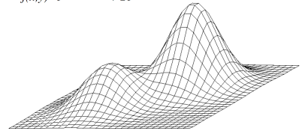
State-Space Landscape
22
Two-dimensional state-space

Slide 23
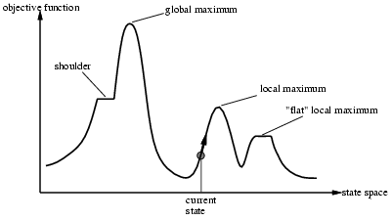
State-Space Landscape
One-dimensional
Can move to the left or to the right in the state space
plateau
23

Slide 24
Optimization problems
Combinatorial optimization - when the set of feasible solutions is discrete

Slide 25
Neighborhood
Sometimes, the search space S (which as we remember is simply a set) is equipped with a neighborhood relation (called also successor relation) N: S→S.
Equivalently, one can think of a neighborhood function N: S→Pow(S) which, for each feasible solution s∈S defines a set of neighbors of s, N(s)⊆S.
The neighborhood relation may be based on some kind of similarity/distance between solutions.

Slide 26
Neighborhood
The neighborhood relation is used when solving a search problem using a local search algorithm.
Utilizing the neighborhood relation, we can “upgrade” the search space (a set) into a search graph (called also a neighborhood graph) which is a directed graph with a node set S and an arrow from node s to node s’ iff s’ is a neighbor of s, i.e., s’∈N(s).
Instead of a search graph one may use a search tree.

Slide 27
Neighborhood
Recall state space in AI

Slide 28
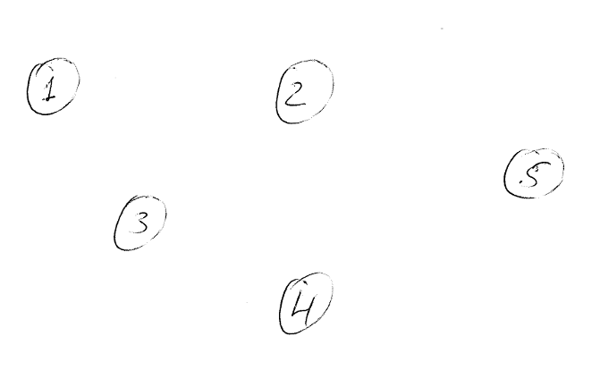
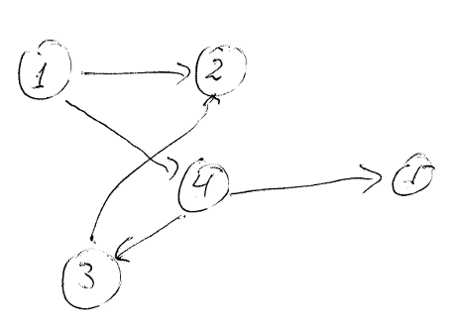
Solution space is a set
Solution space is a graph
N(1) = {2,4}
N(2) = ∅
N(3) = {2}
N(4) = {1,3,5}
N(5) = ∅

Slide 29
Problems
Problem solving
Algorithms
Programs

Slide 30
Problem Solving
Informal and Formal problems and Problem Solving
Traits of formal problem solving:
precise input (initial conditions, initial state)
precise output (goal conditions, final state)
solution’s method is a complete yet finite sequence of simple enough precise steps (a “procedure” or “algorithm”)
there is an agent (computer, human) that can execute each step of the solution; the steps belong to a set of “legal” actions for that agent

Slide 31
Intuitive Notion of an Algorithm
Algorithm: A finite well-ordered collection of unambiguous and effectively executable operations that, when executed, produces a result and halts in a finite amount of time

Slide 32
Algorithms
An algorithm consists of ordered steps:
STEP 1: Do something
STEP 2: Do something
STEP 3: Do something
. .
. .
. .
STEP N: Stop, you are finished

Slide 33
Algorithms
Computing agent:
A machine, robot, person, or thing understanding and carrying out the steps of the algorithm
Does not need to understand the concepts or ideas underlying the solution

Slide 34
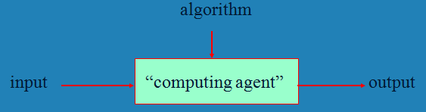
Algorithm

Slide 35
Formal Definition of an Algorithm (continued)
Unambiguous and effectively executable operation
An operation that can be understood and carried out directly by the computing agent without need to be further simplified or explained

Slide 36
Formal Definition of an Algorithm (continued)
A primitive operation (or a primitive) of the computing agent
Operation that is unambiguous for computing agent
Primitive operations of different individuals (or machines) vary
An algorithm must be composed entirely of primitives for the corresponding computing agent

Slide 37
Recall: Formal Definition of an Algorithm
Algorithm: A finite well-ordered collection of unambiguous and effectively executable operations that, when executed, produces a result and halts in a finite amount of time

Slide 38
The Formal Definition of an Algorithm (continued)
The result of the algorithm must be produced after the execution of a finite number of operations
Infinite loop
The algorithm has no provisions to terminate
The termination condition never fulfils
A common error in the designing of algorithms

Slide 39
Algorithms and Programs
Programming can be viewed as the process of designing and implementing algorithms that a computer can carry out
A programmer’s job is to:
design an algorithm for solving a problem, then
translate the algorithm into a program, i.e. represent the algorithm using a programming language that the computer can understand (after translation);
also called coding the algorithm

Slide 40
Algorithms and Programs
Computer program – an implementation (representation) of an algorithm in a given programming language
Different programs can represent the same algorithm
40

Slide 41
Formal Definition of an Algorithm
In Computation theory – formally defined computation models

Slide 42
Types of Operations (in high-level programming languages)
Categories of operations used to construct algorithms
Sequential operations
Carries out a single well-defined task; when that task is finished, the algorithm moves on to the next operation
Examples:
Add 1 cup of butter to the mixture in the bowl
Subtract the amount of the check from the current account balance
Set the value of x to 1

Slide 43
Types of Operations (in high-level programming languages)
Sequential operations
A; B
Graphically
A
B

Slide 44
Types of Operations
Conditional operations (decisions)
Ask a question (check a condition) and then select the next operation to be executed on the basis of the answer to that question
Examples
If the mixture is too dry, then add one-half cup of water to the bowl
If the amount of the check is less than or equal to the current account balance, then cash the check; otherwise, tell the person that the account is overdrawn
If x is not equal to 0, then set y equal to 1/x; otherwise, print an error message that says we cannot divide by 0

Slide 45
Types of Operations (in high-level programming languages)
Conditional operations
If c then A
else B
Graphically
[true]
c
[false]
A
B

Slide 46
if-elif-else in Python [draw activity diagram]
= case

Slide 47
Types of Operations
Iterative operations (Loops, Repetitions)
Tells us to repeat the execution of a previous or subsequent block of instructions if a given condition is fulfilled
Examples
Repeat the previous two operations until the mixture has thickened
Repeat the following two operations 10 times.
While there are still more cheques to be processed, do the following five steps
Repeat steps 1, 2, and 3 until the value of y is equal to 11
Graphically … Modifications with pre- and post-condition

Slide 48
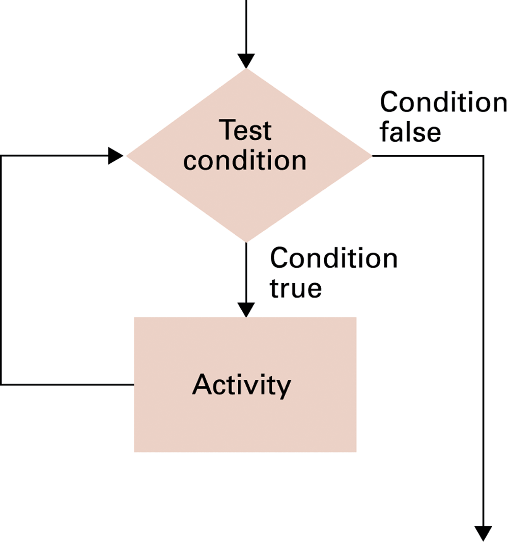
The while loop structure
While c do A
In Python
While c:
A
c
A

Slide 49
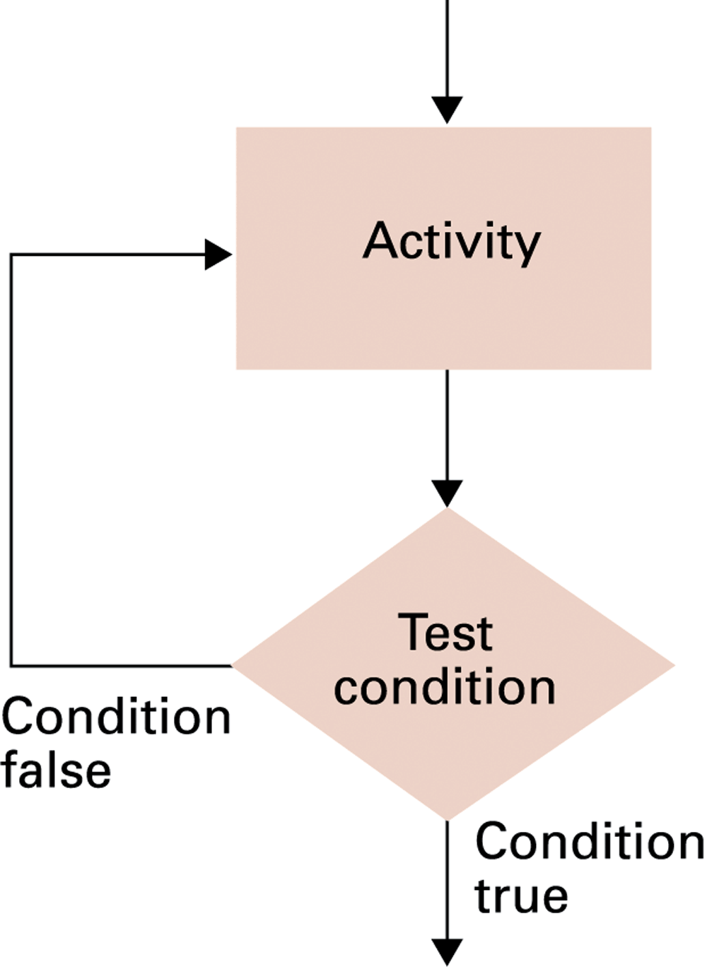
The repeat loop structure
Repeat A until c
A
c

Slide 50
The repeat loop structure
Does not exist in Python
How can we achieve the same effect?

Slide 51
Types of Operations
Invocations (sub-algorithm calls)
Call an existing, named algorithm A to solve a sub-problem
call A
┌┼┐ A

Slide 52
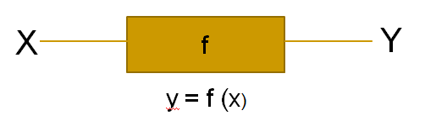
Instances
Instances of an algorithm are the different inputs (cases) for the same algorithm
For example, the values of the elements of the list

Slide 53
Size of an Instance
The size of an instance is some measure of the number of the components of the instance
Most often is an integer – e.g. the number of people in the room
Can be an ordered tuple, eg <n,m> for an nxm matrix, or <n,a> where n is the number of nodes and a the number of arrows in a graph

Slide 54
Elementary operation
Elementary operation is an operation that is upper-bounded by a constant amount of time regardless of the input (instance)
Most importantly, this time does not depend on the size of the instance
In previous examples, time of all operations is bounded from above
Comparison
Assignment
These operations are elementary operations
Efficiency is measured through the number of elementary operations

Slide 55
Is max() on lists in Python an elementary operation?

